Slide 1
Generative Adversarial Networks (GANs)
A gentle Introduction
https://github.com/toelt-llc/GANs-TensorFlow
Umberto Michelucci
umberto.michelucci@toelt.ai
+41 79 396 7406

Slide 2





Who am I
Head of AI Center of Excellence @ Helsana Versicherung AG
Master in Theoretical Physics and PhD in Computer Science and Machine Learning
Author of «Applied Deep Learning –A Case-Based Approach to Understanding Deep Neural Networks» (APRESS 2018)
Author of «Advanced Applied Deep Learning – Convolutional Neural Networks and Object Detection» (APRESS 2019)
Founder Toelt GmbH
Google Developer Expert in Machine Learning
More than 25 published papers in the last three years in Machine Learning

Slide 3


Painter: she would like to learn to learn to paint as Van Gogh
Critic: she would like to learn be able to tell real Van Gogh paintings from fakes apart.

Slide 4
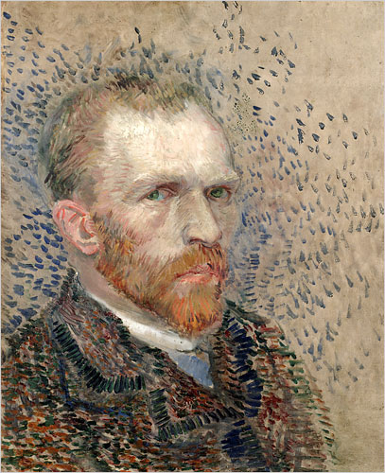
Step 1
The painter becomes slowly better
Then the critic tells the painter what was clearly wrong.
Critic: she would like to learn be able to tell real Van Gogh paintings from fakes apart.
Produce a fake portrait that is not perfect
Painter: she would like to learn to learn to paint as Van Gogh
The critic try to determine if the painting is fake or not.
FAKE

Slide 5
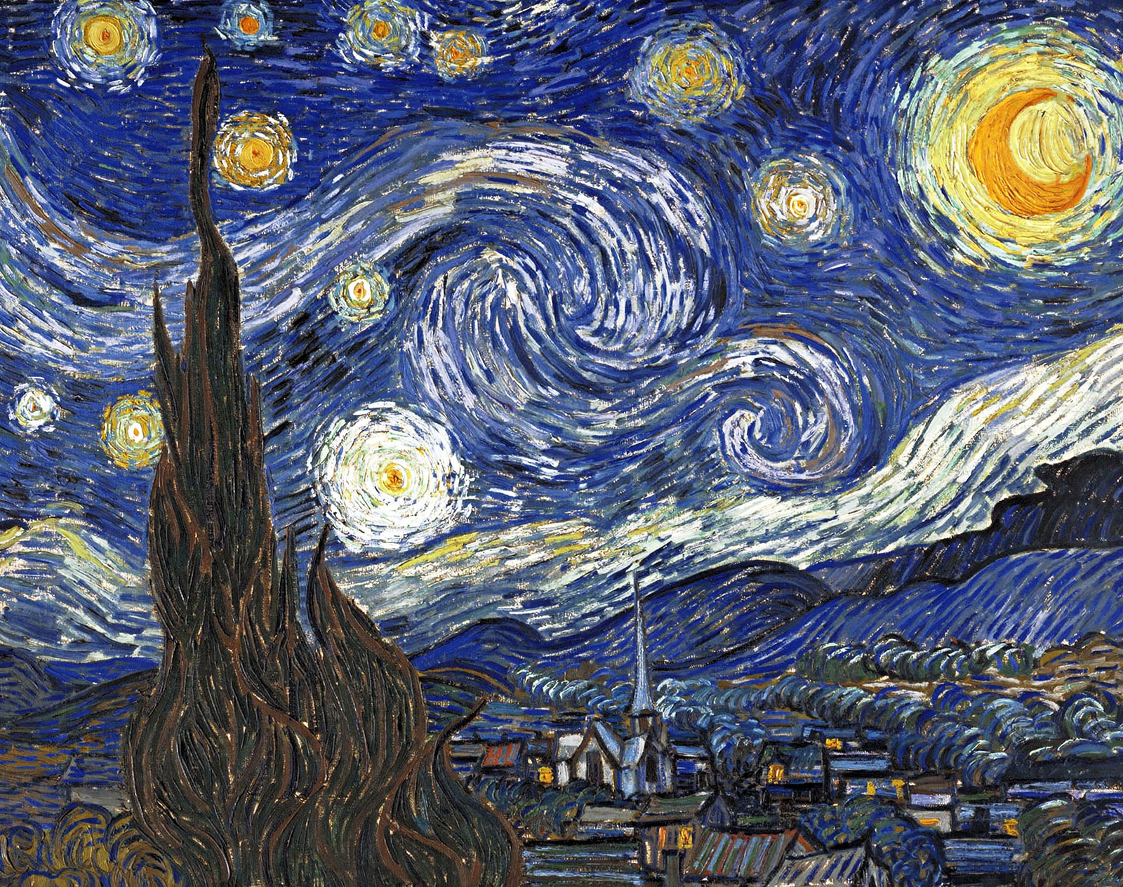
Step 2 – The critic must become better too
The critic trains with real Van Gogh paintings
The critic becomes slowly better
Critic: she would like to learn be able to tell real Van Gogh paintings from fakes apart.
TRUE
The critic trains with clearly fake Van Gogh paintings
FAKE

Slide 6
Reference – Loss Function (Cross Entropy, CE)
Predicted Class probability of painting of being real (class 1)
Class Label: 0,1
0 → Painting is fake
1 → Painting is real

Slide 7
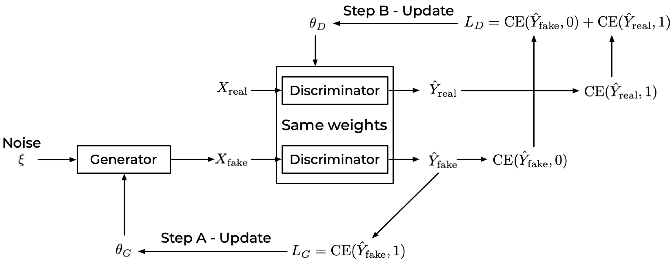
Step 2
Ideas of the painter (today I will paint a portrait,
a landscape, etc.)
Step 1

Slide 9
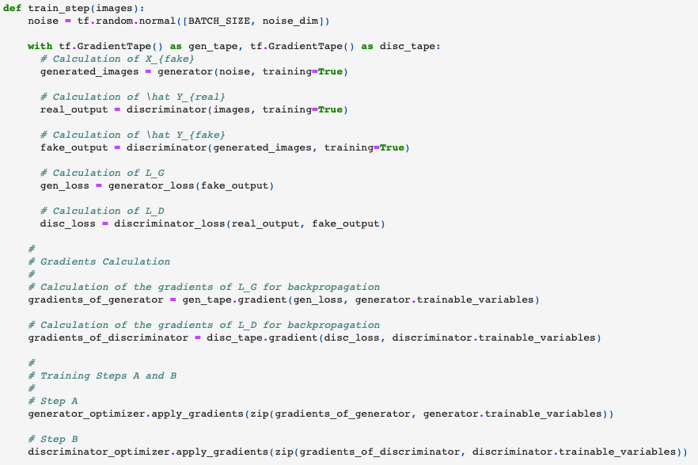




How to use Keras for GANs
The most important aspect of using Keras for GANs is the necessity of building a custom training loop (and not using compile()/fit() approach.

Slide 10
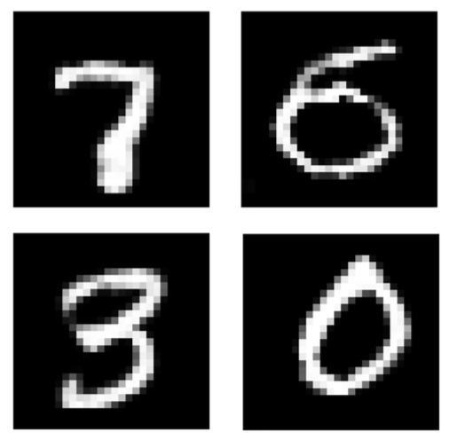
The digits were not written by a person…

Slide 11
Conditional GAN
Conditional GAN (CGAN) is a GAN variant in which both the Generator and the Discriminator are conditioned on auxiliary data such as a class label during training.
Source: https://livebook.manning.com/book/gans-in-action/chapter-8/

Slide 12
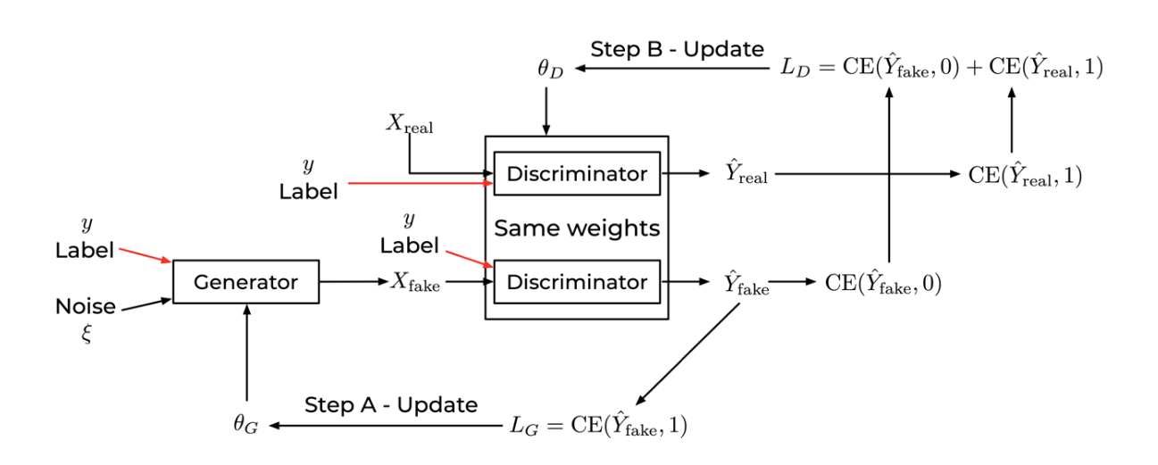
Conditional GAN

Slide 13
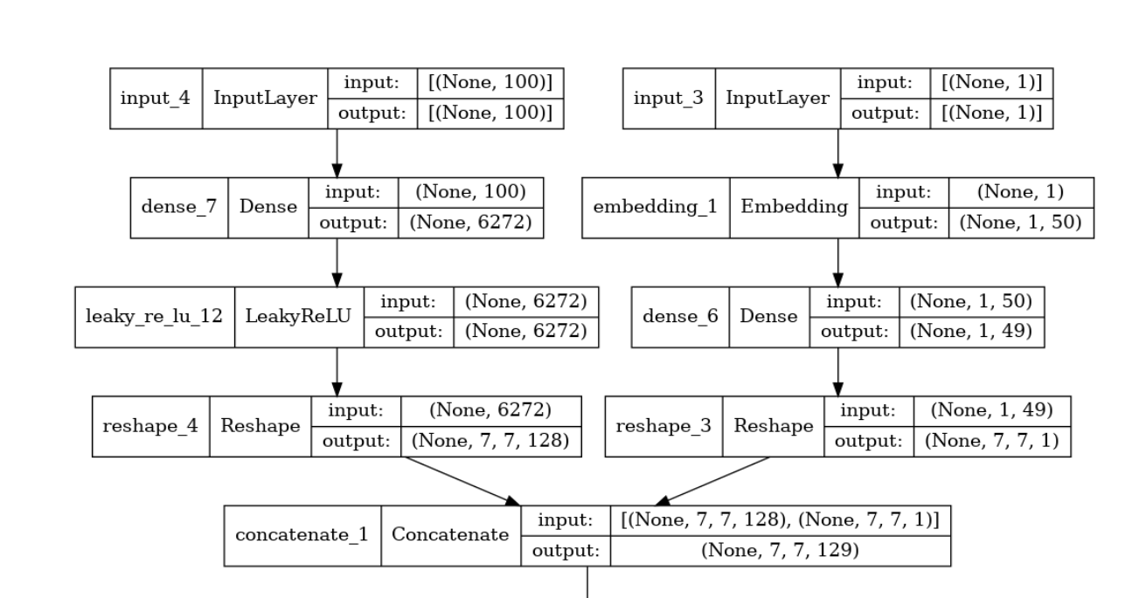
First Layers of the generator (CGAN)

Slide 14
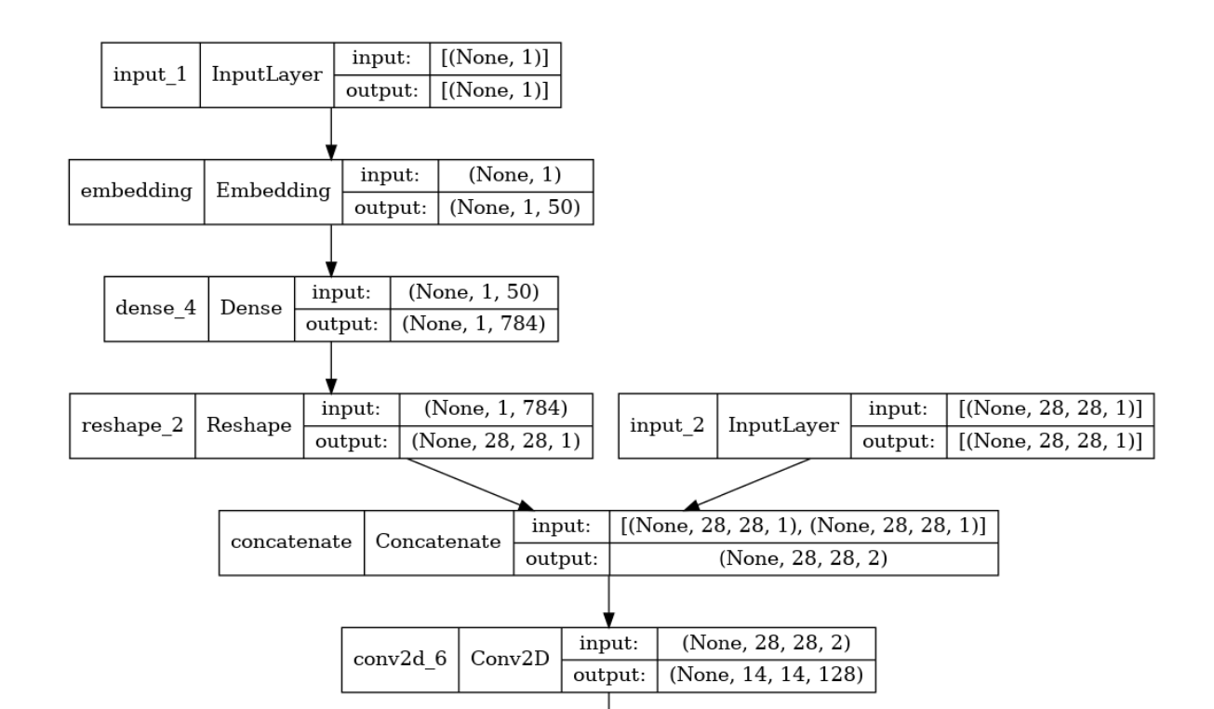
First Layers of the discriminator (CGAN)

